Slide 1
DESIGN DOCUMENTATION FOR MGENI DELICACIES

Slide 2
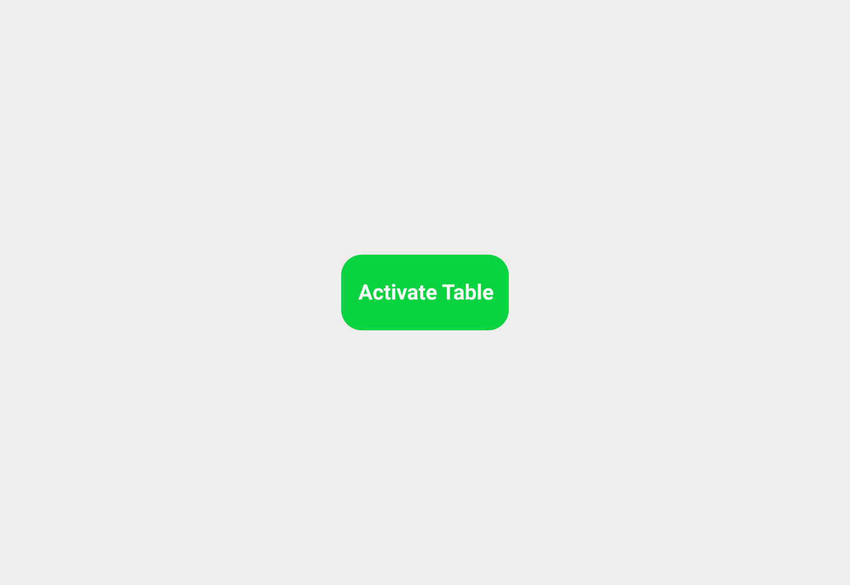

Slide 3
The first step for every customer when they arrive at their table is to activate the table by clicking the button on the screen.
This notifies the staff that a table has been occupied.

Slide 4
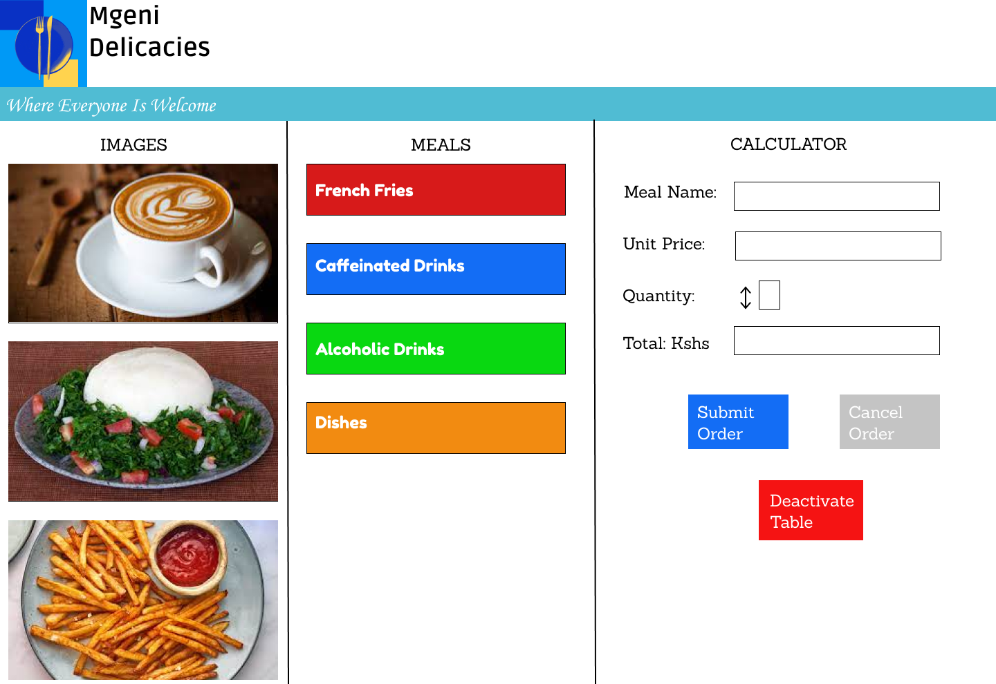
MOCK 1

Slide 5
Mock 1 was a very simple and basic design.
The first section contained dynamic images that would change depending on the button that the customer selects in the second section.
The second section had buttons for the customer to select the meal the customer desires
The third section contains the calculator which shows how much the customer will pay when he/she submits his/her order.
The deactivate table button is used to indicate the staff that the table is free for another customer.

Slide 6
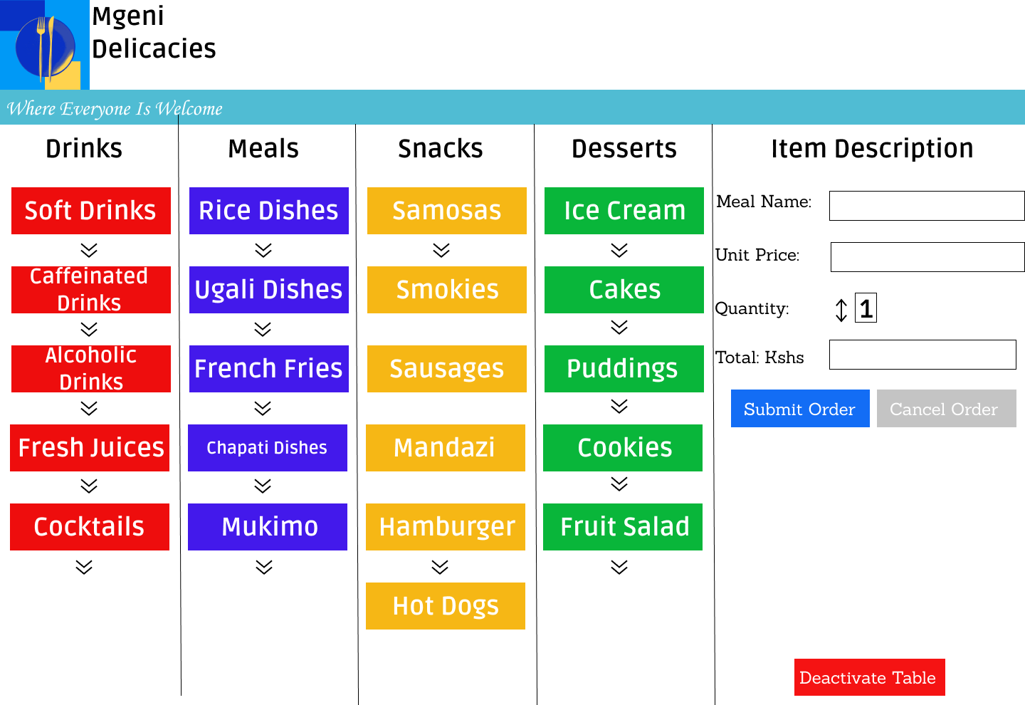
MOCK 2

Slide 7
In mock 2, we tried eliminating the images on the screen.
The classes of food were divided into sections, with each section containing the meals we offer in each section.
When each button is clicked, the drop-down menu is opened containing all the dishes we can offer under each selection.
We also renamed the last section to “Item Description”.
Mock 2 was discarded because it seemed a bit too crowded with buttons.

Slide 8
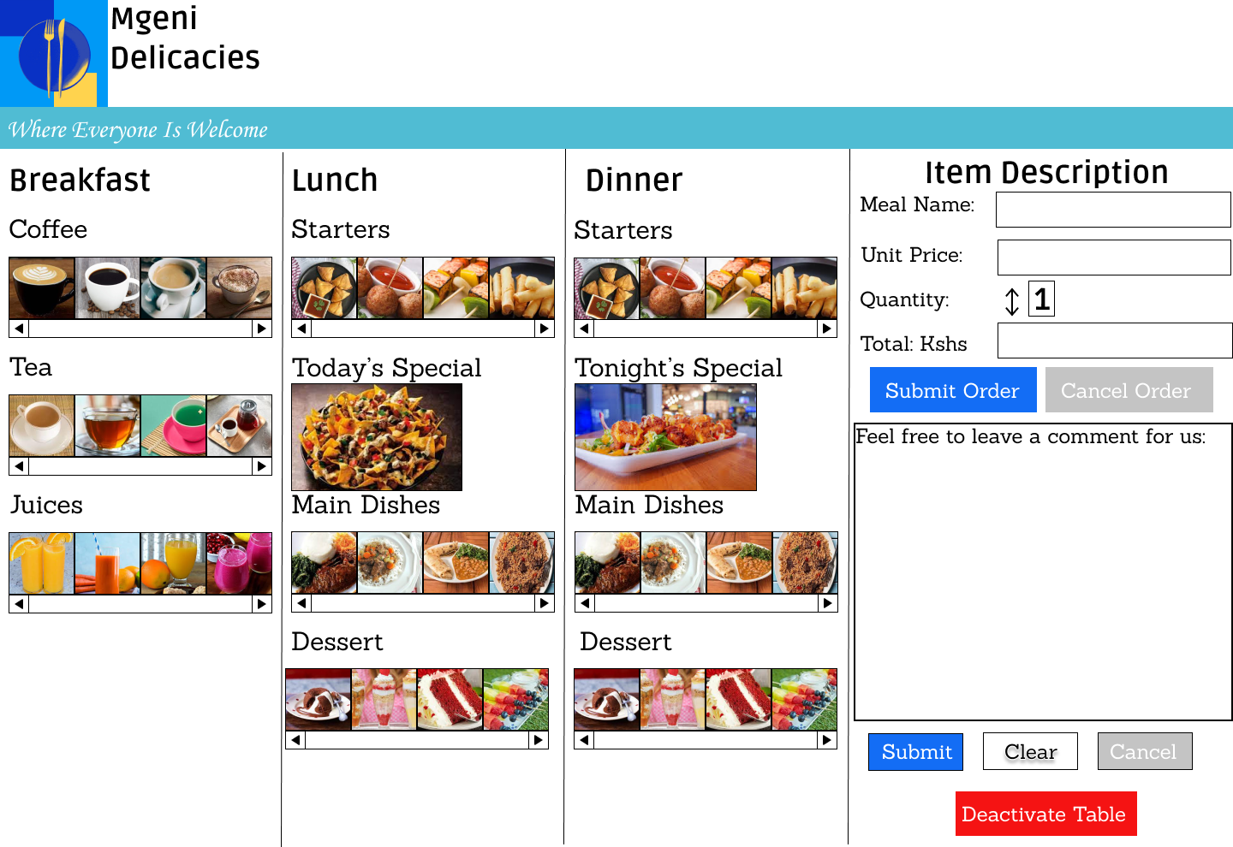
MOCK 3

Slide 9
In mock 3, we tried increasing the amount of images to make the customer visualize what he/she was ordering.
We also added a comment section where the customer could send his complains, compliments and recommendations.
Mock 3 also seemed crowded with images.

Slide 10
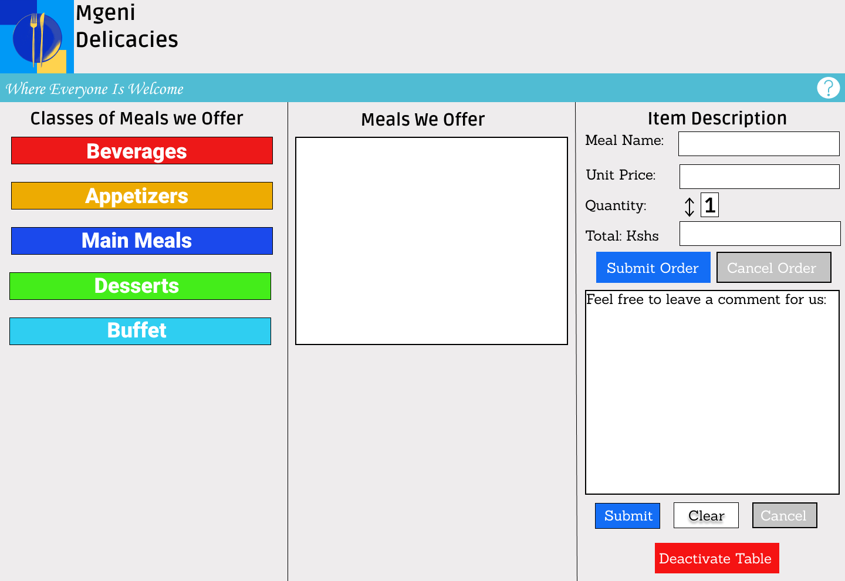
MOCK 4 (FINAL DESIGN)

Slide 11
Mock 4 was the final design that we agreed upon.
It contained the buttons from Mock 1 but this time the buttons were on the first section.
The second section had one large image box which would contain a collection of images depending on the selected class from the first section. The customer would then select the meal he/she would like by clicking on the images shown.
In this design, we also added a Help button at the top of the last section in case the customer needs help in placing his/her order.

